Slide 1






Welcome to Foundation’s
Phonics and Reading Meeting
Notes:
1- Codie

Slide 2



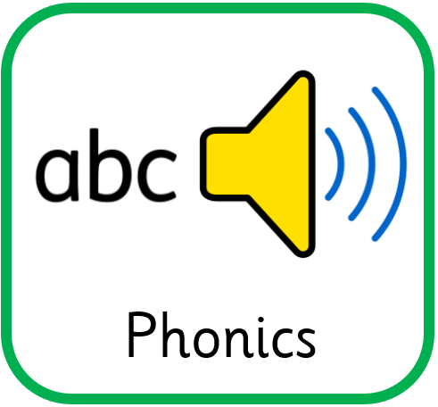


Reading at Westdale
Letters and Sounds forms the basis of our phonics teaching using Jolly Phonics actions.
We use ‘Collins Big Cat for Letters and Sounds’ books so we can carefully match their reading book to their phonic ability and word knowledge.
We teach Phonics and English daily. We also have a story time everyday.
Each child has a 1 to 1 read once a fortnight. They also participate in a shared read within a small group every other week.
Notes:
1

Slide 3
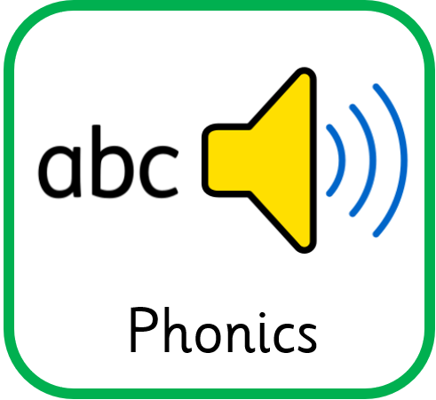
What is Phonics?
Phonics is a way of teaching children how to read and write.
It helps children hear, identify and use different sounds that distinguish one word from another.
Phonics involves matching the sounds of spoken English with individual letters or groups of letters.
Notes:
1

Slide 4
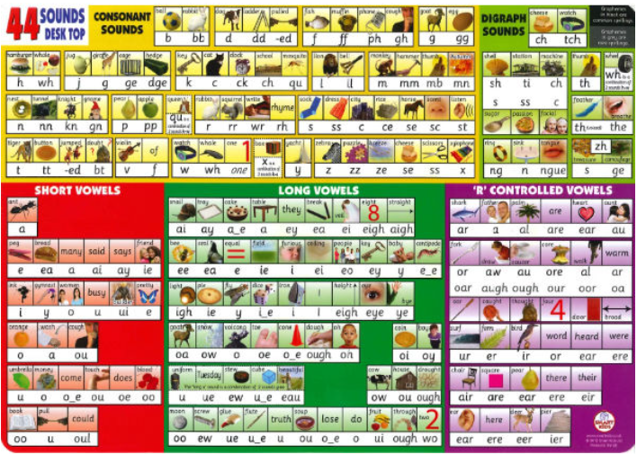
Phoneme
A phoneme is a speech sound.
It is the smallest unit of sound.
There are approximately 44 phonemes in English (it depends on different accents).
Notes:
2- Sarah

Slide 5
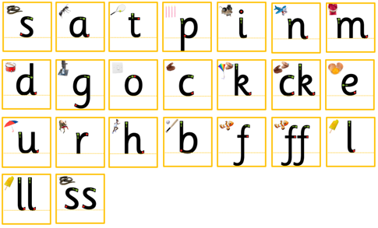
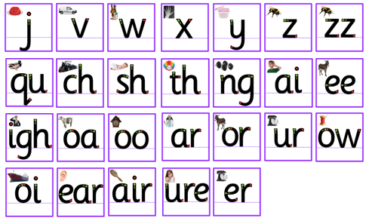
Grapheme
A grapheme is a letter or a number of letters that represent a sound (phoneme) in a word.
Notes:
2

Slide 6

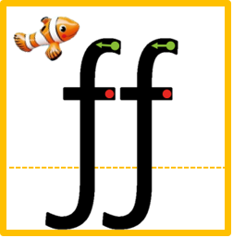
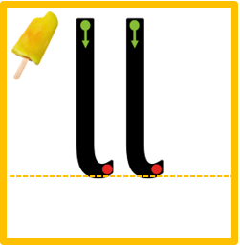








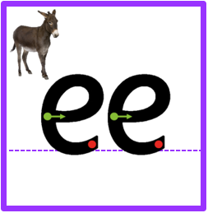
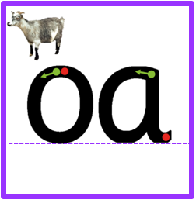
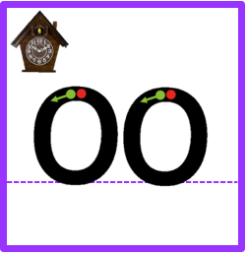

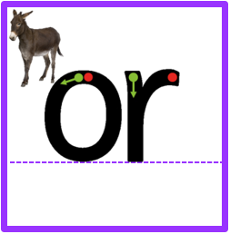


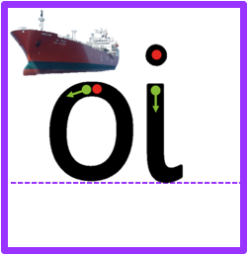

Digraph
Two letters that make one sound (phoneme).
quiz
boat
ring
Notes:
2

Slide 7




Activity
Trigraph
A grapheme containing three letters that make one sound (phoneme).
night
ear
bear
hair
pure
Notes:
2

Slide 8
Underline the digraphs and trigraphs.
Put a dot under the single phonemes.
Activity
kick | huff | fill | miss | buzz
quick | rich | shop | thin | ring
rain | week | coat | hoop | book
card | fork | turn | down | coin
herb | jumper | light | fear | cure
Notes:
2

Slide 9
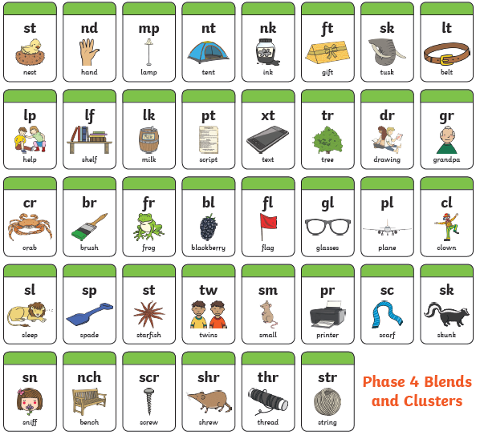
Cluster
Consonants together in a word that can be blended first. This gives the children less to remember.
Note- they still have individual sounds so they are not digraphs/ trigraphs
nest scarf
belt string
shelf plant
Notes:
1

Slide 10
Pure Sounds
Keep the sound short. Do not stretch it out.
Your mouth should make one shape.
DON’T
add an ‘uh’ at the end.
Notes:
1

Slide 11

Blending
Oral Blending - This involves hearing phonemes and being able to merge them together to make a word. Children need to develop this skill before they will be able to blend written words.
Blending- This involves looking at a written word, looking at each grapheme, sounding them out and then merging these phonemes together to make a word. This is the basis of reading.
Notes:
1

Slide 12
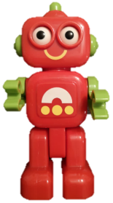
Activity
Segmenting
Oral Segmenting - This involves hearing a whole word and then splitting it up into the phonemes that make it. Children need to develop this skill before they will be able to segment words to spell them.
Segmenting - This involves hearing a word, splitting it up into the phonemes that make it and then writing those graphemes down in the right order. This is the basis of spelling.
Robot talk
Notes:
1

Slide 13
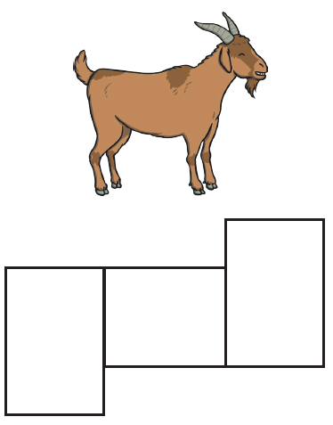
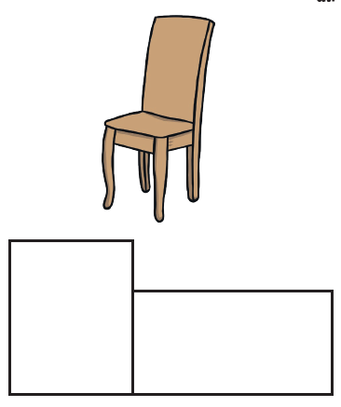
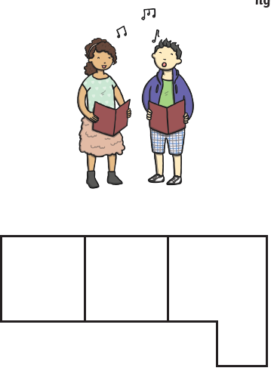
Activity
g
oa
t
s
i
ch
air
ng
Robot talk
Notes:
1

Slide 14
Chunking
Breaking a longer word up into smaller ‘chunks’ so the child has less to remember.
backpack
backpack
Notes:
2

Slide 15
Foundation
In Foundation Stage the children learn phase 2 and phase 3 phonemes.
They should be able to identify what the phoneme is and spot it within a word.
They should be using these phonemes to segment to spell words and blend to read words.
Notes:
2

Slide 16
Foundation
In Foundation Stage the children also cover phase 4. During this time they recap phase 2 and phase 3 while also exploring clusters within words.
Notes:
2

Slide 17
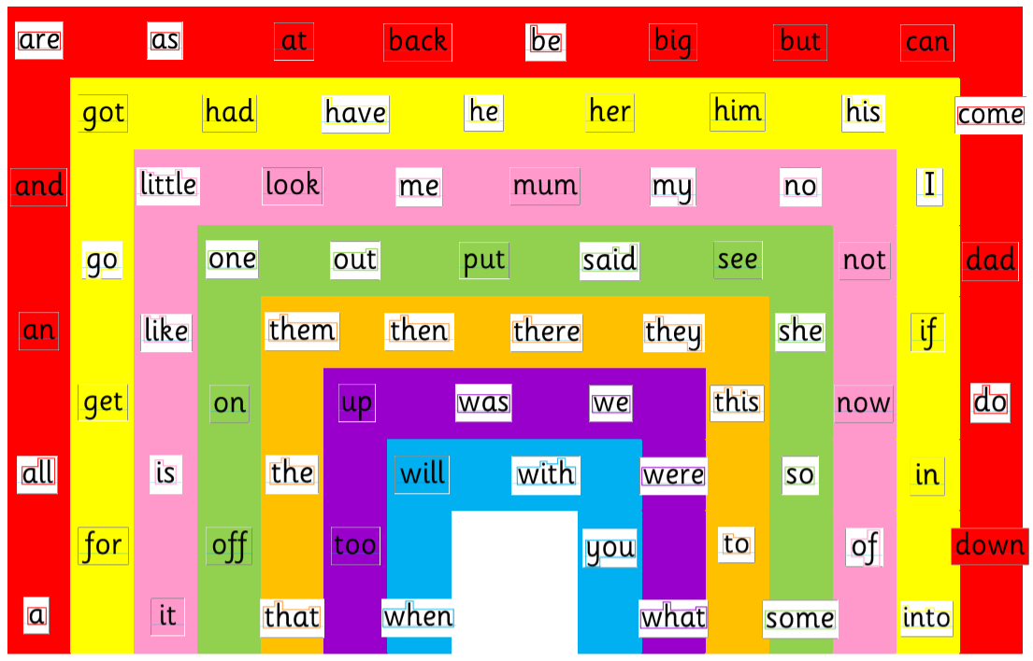

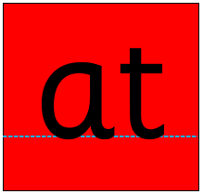
Foundation
In Foundation Stage we also cover these tricky words. The children should be able to instantly recognise them by sight. We look at the shape of the word to help with this and practise spotting them in lots of different places. We also cover these high frequency words. Although they can be sounded out it helps with fluency if they can be recognised straight away.
Notes:
2

Slide 18
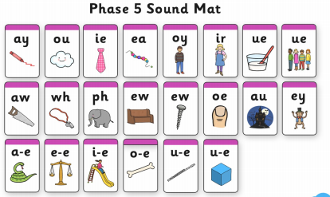
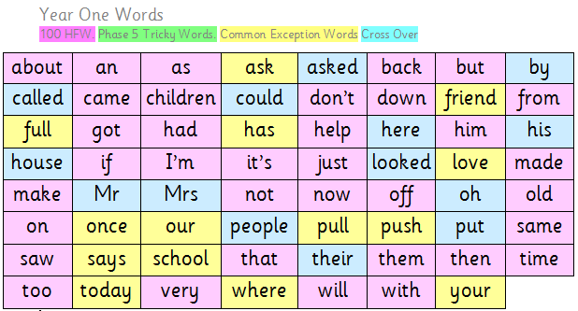
Year One
In Year One they will move onto Phase 5 phonemes.
Year One have their own set of high frequency/ tricky words to learn.
All children take part in a Phonics Screening Check at the end of Year One.
Notes:
2

Slide 19

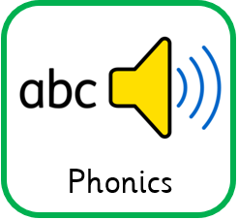


Here is an example of a short phonics carpet input
Fantastic Phonics
Notes:
1

Slide 20



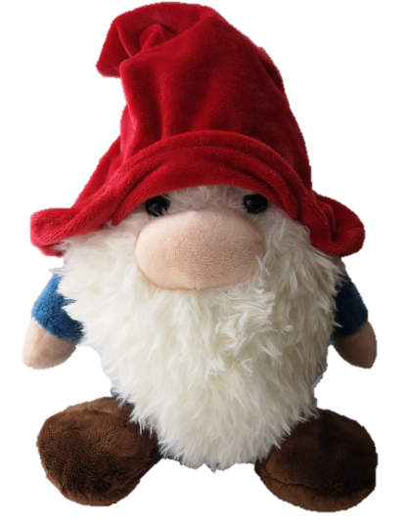
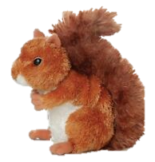
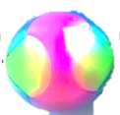
Can you remember my words? Don’t forget these ones are tricky so you can’t sound them out.
Get ready…

Slide 21
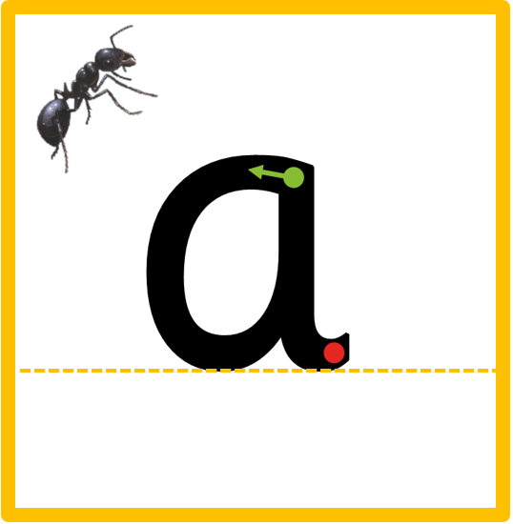




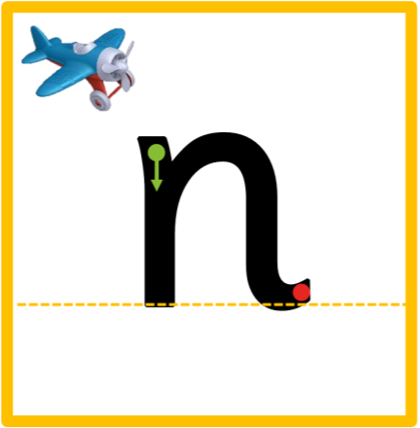
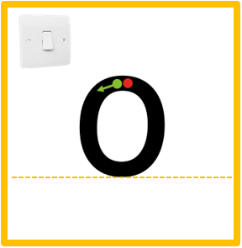
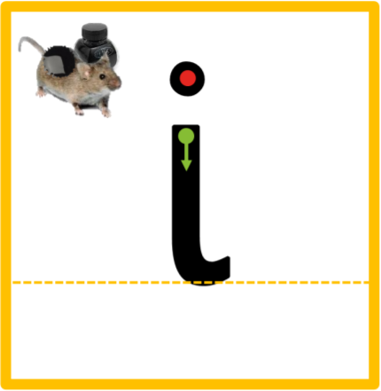


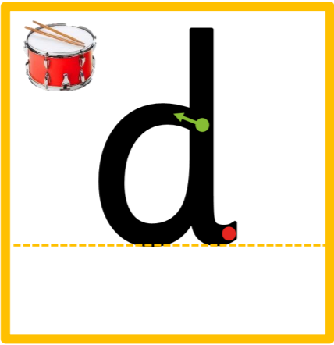

Can you remember our sounds?

Slide 22














Can you segment the words and cross the river if you have that word?
Let’s play a game.
Notes:
Cat, dog, kid, cap, kit, can, pot, dig, pig

Slide 23

Notes:
Cat, dog, kid, cap, kit, can, pot, dig, pig

Slide 24

Notes:
Cat, dog, kid, cap, kit, can, pot, dig, pig

Slide 25





Slide 26

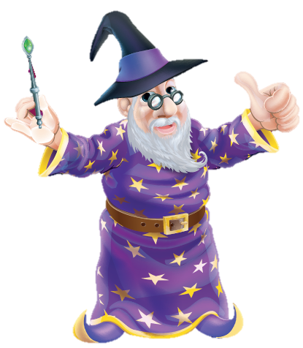
Time to reflect on our learning!
I know the phoneme g,o,c,k.
I can robot talk and blend to read words.
I can read a short sentence.

Slide 27
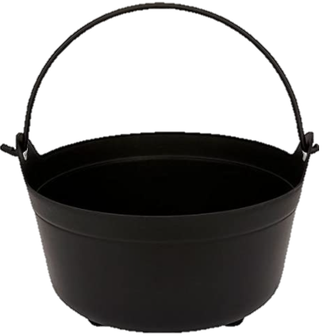
Phonics Games
Around the room
Silly soup
What’s in the box?
What’s missing?
Changing seats
Odd one out
Matching games
Sorting games
I spy
Fastest finger
Notes:
2

Slide 28
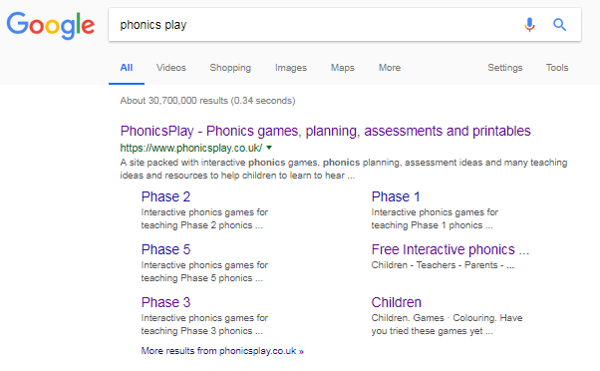
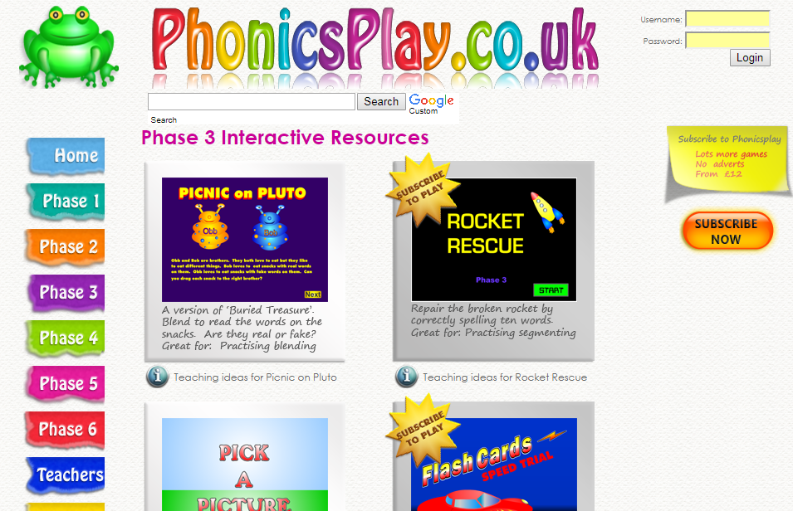
Phonics Games
Click on ‘FREE PHONICSPLAY’
Click on ‘PARENTS’
Click on ‘INTERACTIVE RESOURCES’
Choose which phase you want to practise: Phase 2, Phase 3, Phase 4
A list of games will come up. You can choose a particular phoneme you want to focus on.
Notes:
2

Slide 29
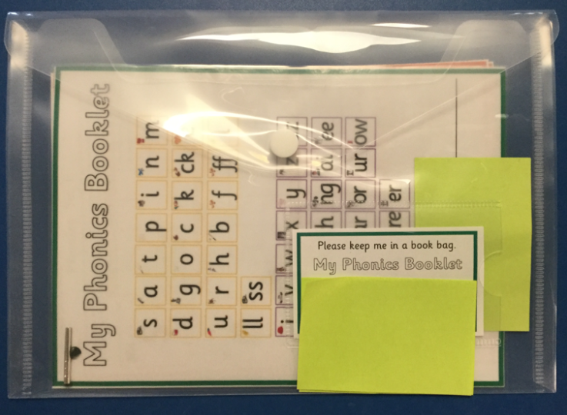
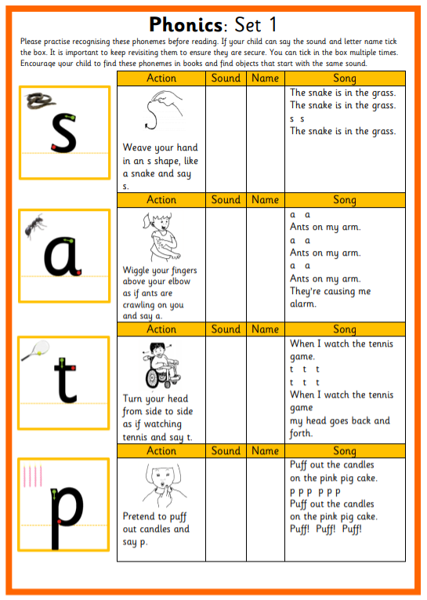
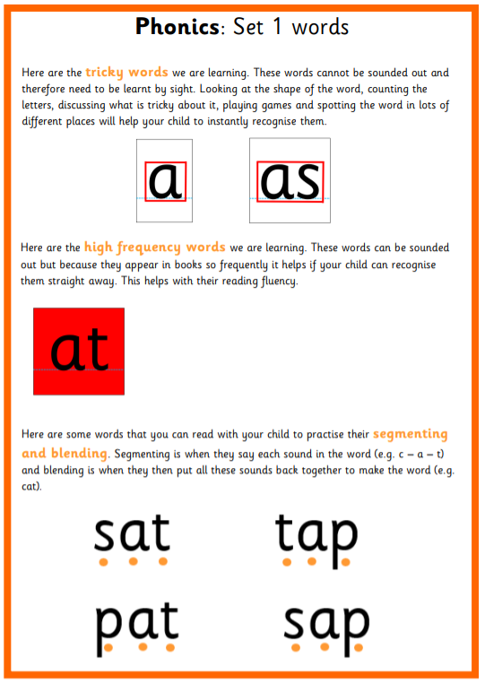
Phonics Booklet
Notes:
2

Slide 30

End of year expectations-
Reading
Comprehension- Expected | Word Reading- Expected
Demonstrate understanding of what has been read to them by retelling stories and narratives using their own words and recently introduced vocabulary. | Say a sound for each letter in the alphabet and at least 10 digraphs.
Anticipate- where appropriate- key events in stories. | Read words consistent with their phonic knowledge by sound-blending.
Use and understand recently introduced vocabulary during discussions about stories, non-fiction, rhymes and poems and during role-play. | Read aloud simple sentences and books that are consistent with their phonic knowledge, including some common exception words.
(tricky words)
Notes:
1

Slide 31
Book Bands
Band | Colour | Year Group Expectation
11 | Lime
10 | White | End of Year 2
9 | Gold
8 | Purple
7 | Turquoise | End of Year 1
6 | Orange | End of Year 1
5 | Green
4 | Blue
3 | Yellow | End of Foundation
2B | Red | End of Foundation
2A | Red
1B | Pink
1A | Pink
0 | Lilac
Notes:
1

Slide 32
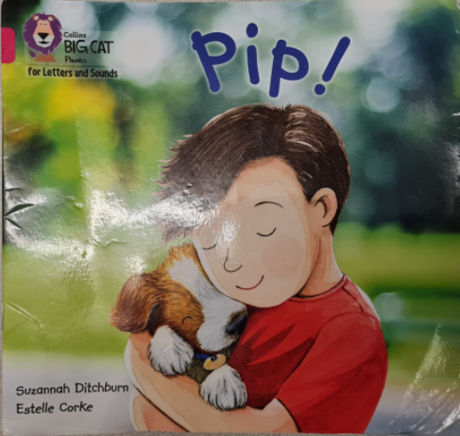
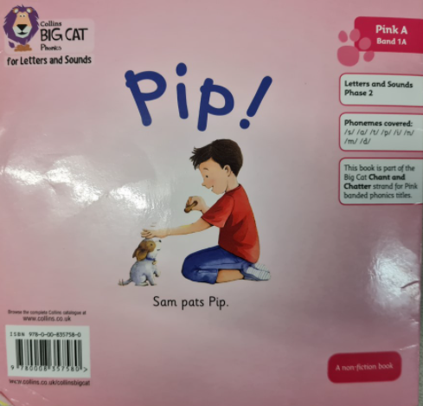
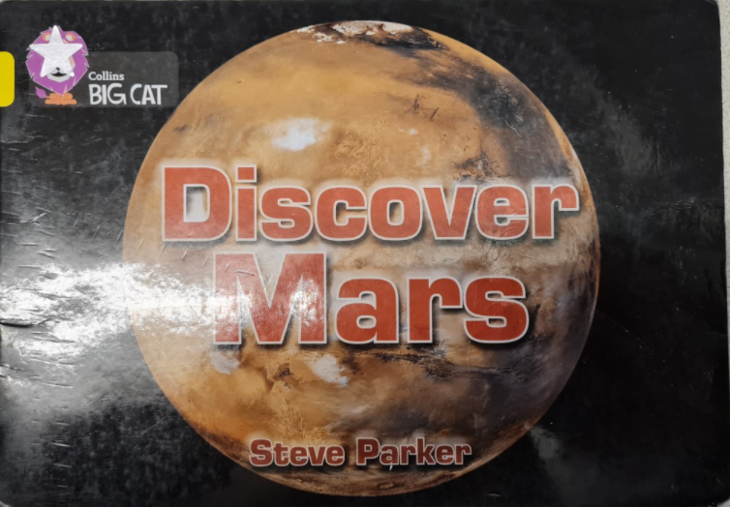
School Reading Books
School Reading Book: This is a colour banded book (Lilac, Pink, Red, Yellow) which is carefully selected by the teacher to match the child’s phonic ability and word knowledge. We recommend that your child reads it at least 4 times before it gets changed.
On the back it highlights the book band and the phonemes that are included in the book.
Free Choice Book: This is a book your child selects. It may be easier/harder than your child’s book band. You can read this book to your child, they do not have to read it themselves. The purpose of having a free choice book is mainly to develop a love of reading but it also helps develop their comprehension and widens their vocabulary. . It should have a star sticker on to show that this is a free choice book.
Notes:
1

Slide 33
Lilac
Lilac band books support Phase 1 of Letters and Sounds. They are wordless books to support children in telling a story through pictures and are designed to help develop an understanding about how stories work.
 | Band 0 - Lilac
1 | Hold a book correctly.
2 | Locate title.
3 | Recognise front and back cover.
4 | Turn pages appropriately.
5 | Look at the pages in the correct order.
6 | Listen carefully to stories.
7 | Relate stories to their own experience.
8 | Retell story in own words using pictures to support.
9 | Use some story language/ repeated language patterns.
10 | Show awareness of rhyme and alliteration.
Notes:
1

Slide 34
Pink 1A
Pink 1A band books support Phase 2 of Letters and Sounds. They include simple text supported by illustrations. Books use no more than one line per spread, and a simple phrase with a repeated pattern.
 | Band 1A- Pink
1 | Locate the title.
2 | Know that the left page comes before right and consistently turn pages appropriately.
3 | Know where the text starts. Understand that we read print from left to right.
4 | Can differentiate from text and illustration.
5 | Start to match spoken word to printed word (one-to-one correspondence)
6 | Locate familiar words or letters (s, a, t, p, i, n, m, d)
7 | Answer simple questions about the story.
8 | Predict the story line.
Notes:
1

Slide 35
Pink 1B
Pink 1B band books support Phase 2 of Letters and Sounds. They offer simple, predictable text with familiar objects and actions. 4-5 word sentences are included per spread, and the pattern is then repeated on each page with usually no more than one word changing from one page to next.
 | Band 1B- Pink
1 | Identify the title.
2 | Use some letters together with meaning to read the text, including CVC words.
3 | Match spoken to printed word (one-to-one correspondence) across 2-3 lines of print.
4 | Use the meaning of the text (contextual clues).
5 | Extend vocabulary.
6 | Begin to be aware of the way stories are structured.
7 | Predict some vocabulary.
8 | Locate familiar words or letters (s, a, t, p, i, n, m, d, g, o, c, k, ck, e, u, r, h, b, f, ff, l, ll, ss).
Notes:
1

Slide 36
Red 2A
Red 2A band books support Phase 3 of Letters and Sounds. They include predictable text with familiar objects and actions which is combined with simple story development
 | Band 2A- Red
1 | Locate and recall title.
2 | Consolidate secure control of one-to-one matching on a wide range of texts.
3 | Recognise print structure of a word, individual letters and the space between words.
4 | Locate familiar words or letters (j, v, w, x, y, z, zz, qu, ch, sh, th, ng)
5 | Solve simple words by blending phonemes from left to right (CVC)
6 | Predict the story line and some vocabulary.
7 | With support, can comment on texts e.g. on personality of main characters.
Notes:
1

Slide 37
Red 2B
Red 2B band books support Phase 3 of Letters and Sounds. They offer simple but varied text with familiar objects and actions, combined with simple story development and a satisfying conclusion.
 | Band 2B- Red
1 | Locate familiar words or letters (ai, ee, igh, oa, oo, ar, or, ur, ow, oi, ear, air, ure, er).
2 | Check for meaning, correct syntax i.e. does it make sense and sound right?
3 | Begin to notice own errors.
4 | Start to read more rhythmically.
5 | Repeat words, phrases or sentences to check, confirm or modify own reading.
6 | Retell narratives in correct sequence, drawing on language patterns of stories.
7 | Respond with relevant comments, questions or actions.
Notes:
1

Slide 38
Yellow
Yellow band books support Phase 4 of Letters and Sounds. They offer more varied sentence structure and natural language. Fiction features more variation in pattern with more new words. Non-fiction uses personal experiences and simple non-fiction tools such as diagrams, labels and captions.
 | Band 3 - Yellow
1 | Follow print with eyes, finger-pointing only at points of difficulty.
2 | Take more note of punctuation for grammar and oral language rhythms.
3 | Self-correct.
4 | Note familiar words and phonemes and use these to get to unknown words.
5 | Notice relationships between one text and others.
6 | Read accurately by blending sounds noting unusual correspondences between spelling and sound and where these occur in the word.
7 | Read words of more than one syllable.
8 | Re-read books to build up fluency and confidence in word reading.
9 | Search for information in print.
10 | Confirm new words while reading.
Notes:
1

Slide 39
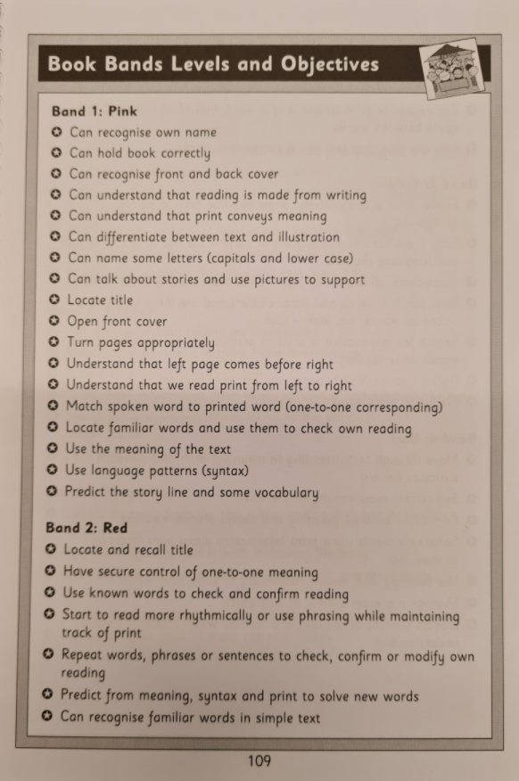
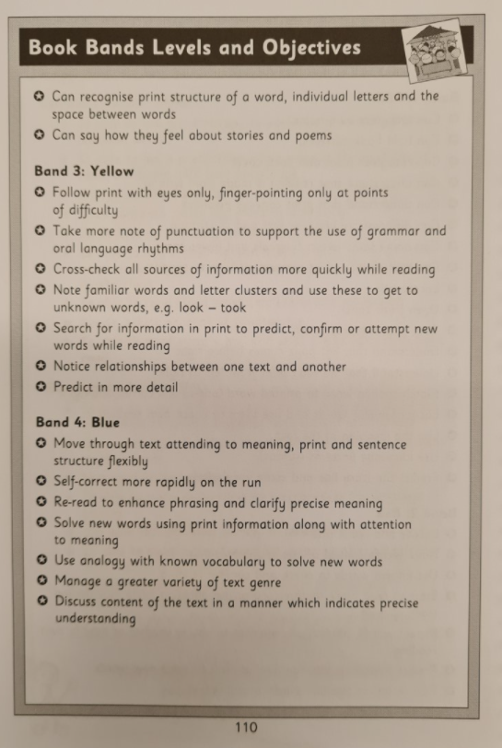
Reading Diaries
These statements can support you with praise and prompts:
Notes:
1

Slide 40
Individual Reading
Being an independent reader- get book out, hold it, turn pages, point to words themselves.
If they get stuck:
Adult asks- What can we do to work that word out?
Sound the word out, think about what would make sense, look at the shape of the word, use picture clues, re-read the sentence
… tell them!
Mistakes
If child makes a mistake don’t immediately correct! Wait and ask at the end of the sentence/page….
- Did that sound right?
- Did that start with the right sound?
- Model the child’s mistake, can they spot it?
Notes:
2

Slide 41
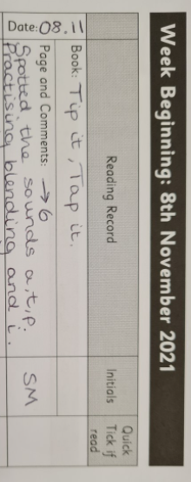
Individual Reading
Praise and Prompt
At end of the read give praise for area they have done well (using phonics to sound out words, using visual information to arrive at a word, re-reading, fluency, expression, punctuation) Then give area for development (prompt).
Notes:
2

Slide 42
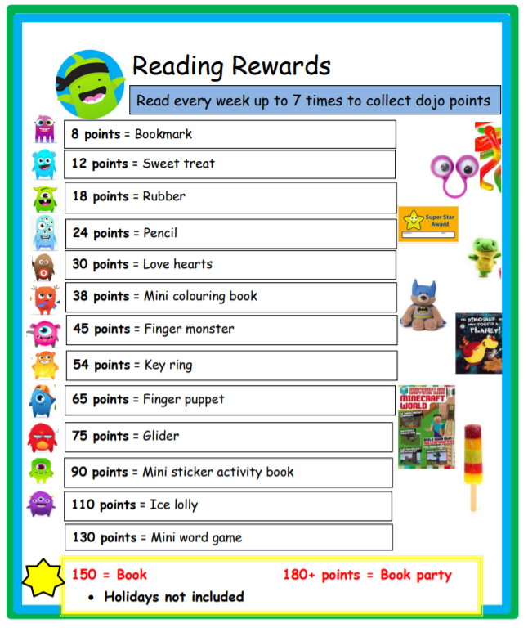
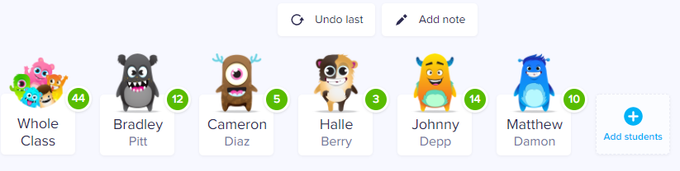
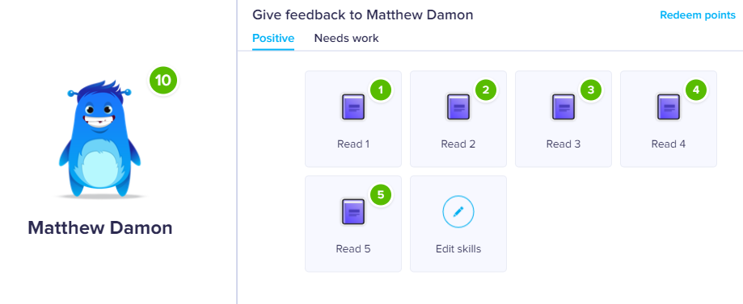
Class Dojo
Notes:
1

Slide 43
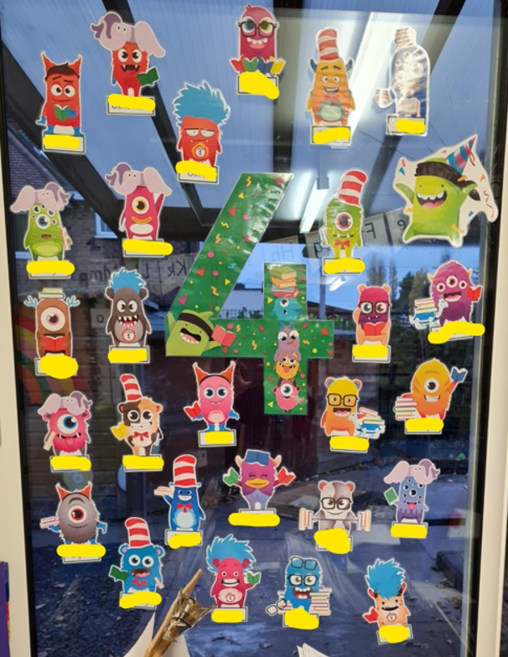
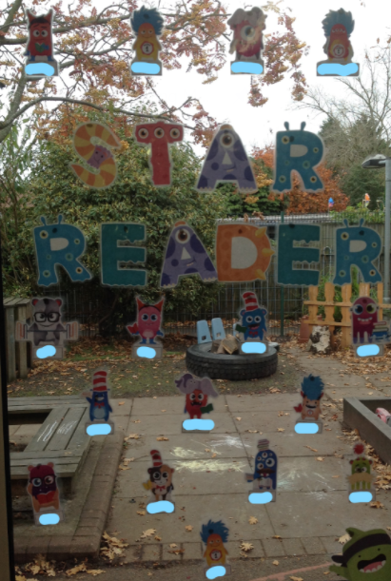
Fantastic 4!
Please try to read with your child at least 4 times a week at home.
Notes:
1

Slide 44




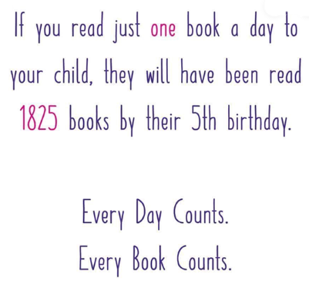

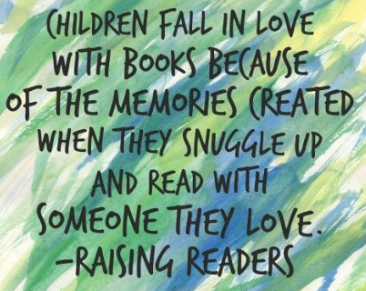
Why are we doing all of this?
Notes:
1

