Slide 1

A Day in the life of a School Site Manager / Caretaker
Andy Curtis

Slide 2
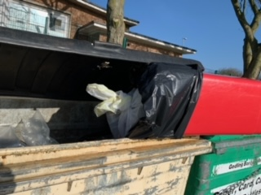
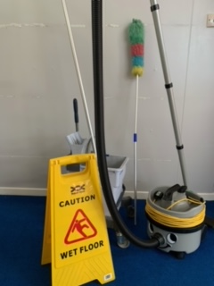
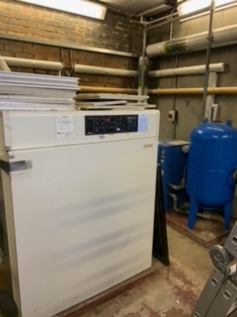

Clean the School with Mrs Mullan and Mrs Williams .
Empty the bins before the you and the teachers arrive after unlocking the school just before 6am whilst most of you are still in bed and making sure the heating is working in the boiler room

Slide 3
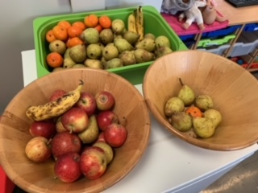
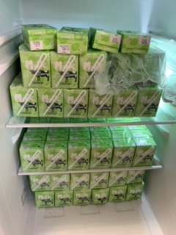
Arrange for the fruit and milk to be collected from the gate and placed in the classrooms around school and throw away any milk cartons that are out of date, or recycle any fruit that has gone off

Slide 4
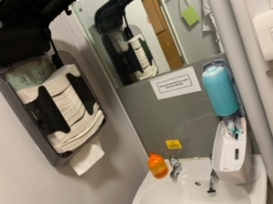
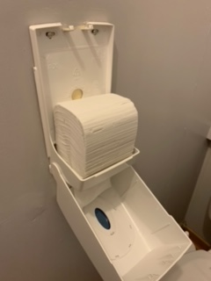
Refill all hand towels, hand sanitisers, toilet tissue and soap dispensers around school each week

Slide 5
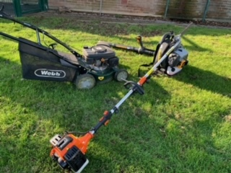
Ensure that school grounds are maintained by mowing the grass areas, trimming the trees, tidying, and clearing away the fallen leaves from the many trees we have around school

Slide 6
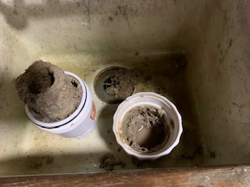
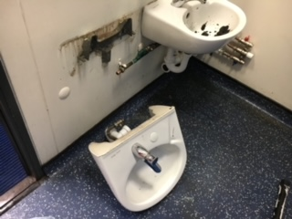
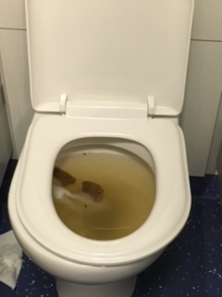
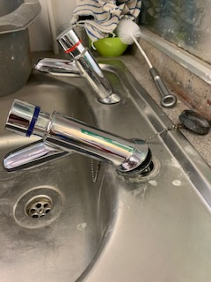
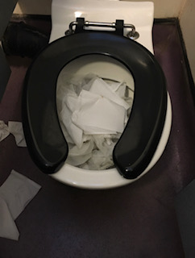
Toilets and toilet areas are checked regularly for damage and blockages – here are some things I have had to deal with:

Slide 7


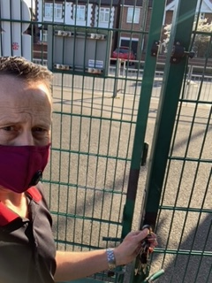



At 8:30 and 3:00, I open the gates to let your parents/grown ups in and close them again for your safety at 9:00 and 3:30.

Slide 8
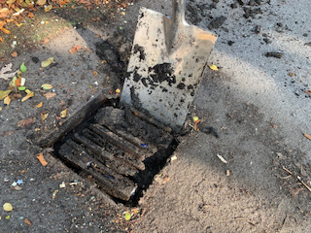
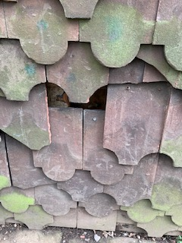
Keep the drains and gutters free from leaves and soil – as you can see they do get full of soil and stones a lot, which blocks them and causes floods when it rains.
I also make sure that no tiles have been damaged around school

Slide 9
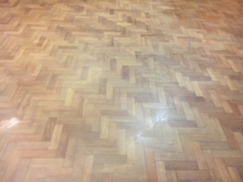
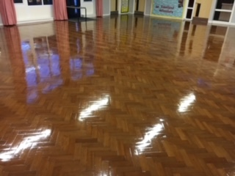
Ensure during the holidays, that all of the carpets are cleaned, all of the furniture is moved and cleaned and finally that the hall floor is polished
This is the Hall floor before polishing
This is the Hall floor after polishing

Slide 10
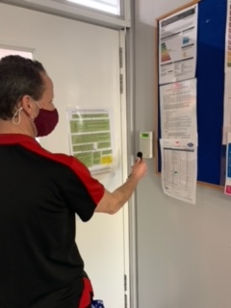
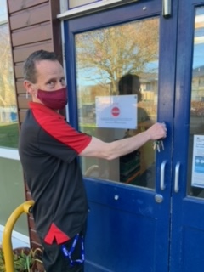
Right after the last teachers have gone home, I make sure all lights are off, all windows are shut and then I set the alarm and lock the school, so that no one can get in to steal school belongings

Slide 11
Site Manager Duties
School building safety – I make sure electrical appliances (like kettles, lap tops, I pads ) and electrical wiring stay safe, I make sure staff know about fire safety, and I ensure your playground equipment is safe for you to use.
Maintain health/hygiene standards – I do this by flushing every tap and every toilet around school each week for 2 minutes each and I make sure that the inside of the school hasn’t been damaged and nothing has been broken.

Slide 12
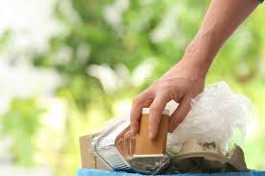
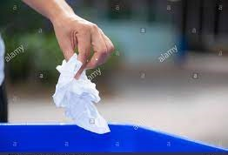
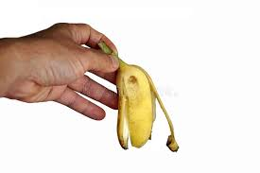
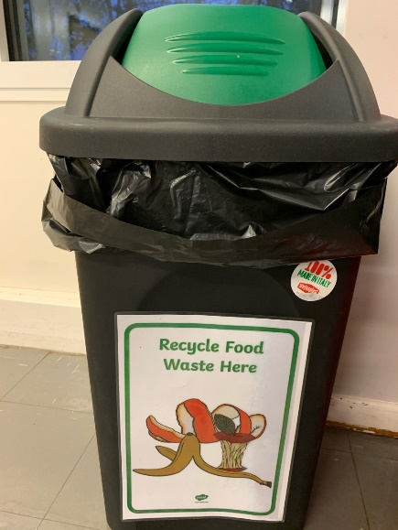
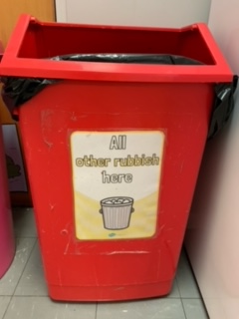
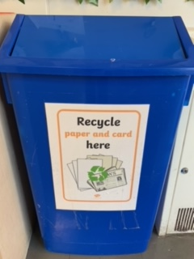
How can you help?
Make sure the right waste goes in the right bins, so school can recycle things and do more to help our environment

Slide 13
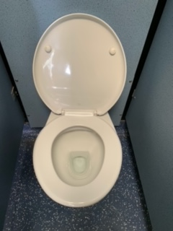
Flush the toilet after you have finished using it (or before if someone has forgotten) 🙈 (Also don’t use too much toilet roll as this causes blockages)
This is how it should look before and after you use it and if you can’t flush the waste away, tell your teacher so we can sort it out for you

Slide 14
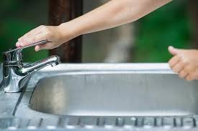


Switch off taps
and lights after use
Don’t pull at the tiles on the outside of the school building
Look after toys, games and other school property as if they were your own
Don’t put soil and stones down drains – you saw earlier what trouble that can cause
Pick up litter (esp. if you are part of my ECO team with your litter pickers)
If you want to know more about what we do as the Eco team, you could either ask your classmates who are in the team, or look at our display on the wall outside the staff room.

